Slide 1
Introduction to React

Slide 2


What is React?
React is a JavaScript framework
Used for front end web development
Think of jQuery, but more structured
Created and used by Facebook
Famous for implementing a virtual dom

Slide 3





Timeline of front-end JavaScript frameworks
jQuery* (2006)
AngularJS (2010)
React (2013)
Vue (2014)
Angular (2014)
* jQuery is more often considered a library than a framework

Slide 4
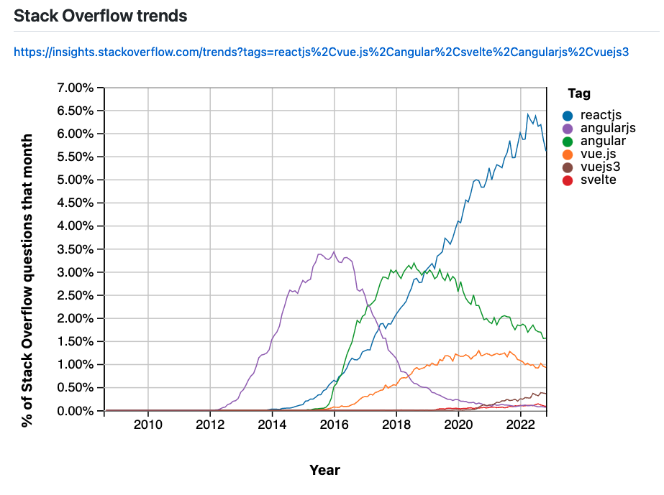
Frontend Framework Popularity

Slide 5
Common tasks in front-end development
App State
Data definition, organization, and storage
User Actions
Event handlers respond to user actions
Templates
Design and render HTML templates
Routing
Resolve URLs
Data Fetching
Interact with server(s) through APIs and AJAX

Slide 6
Fundamentals of React
JavaScript and HTML in the same file (JSX)
  Jsx: JavaScript & XML
Embrace functional programming
Components everywhere

Slide 7



JavaScript and HTML in the same file
HTML
CSS
JS
JSX
CSS or JSS
Traditional approach
React approach

Slide 8
JSX: the React programming language
const first = "Aaron"; const last = "Smith";
const name = <span>{first} {last}</span>;
const list = (
<ul>
<li>Dr. David Stotts</li>
<li>{name}</li>
</ul>
);
const listWithTitle = (
<>
<h1>COMP 523</h1>
<ul>
<li>Dr. David Stotts</li>
<li>{name}</li>
</ul>
</>
);

Slide 9
“React is just JavaScript”

Slide 10
Functional programming
Functions are “first class citizens”
Variables are immutable
Functions have no side effects

Slide 11
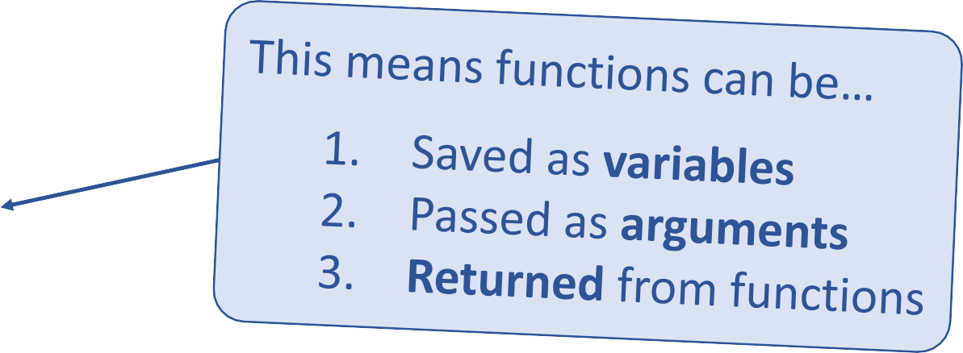
Functional programming
Functions are “first class citizens”
let add = function() { console.log('Now adding numbers'); const five = 3 + 2;
};
function foo() { return function() {
console.log('What gets printed?');
};
}
foo foo(); foo()();
function performTask(task) { task();
console.log('Task performed!');
}
performTask(add);

Slide 12
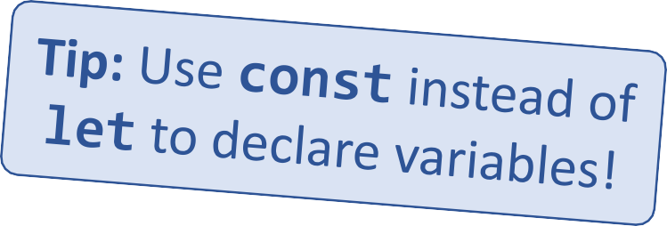
Functional programming
Variables are immutable
let a = 4;
a = 2; // Mutates `a`
let b = [1, 2, 3];
b.push(4); // Mutates `b`
let c = [...b, 4]; // Does not mutate `b`

Slide 13
Functional programming
Functions have no side effects
const b = [];
function hasSideEffects() { b = [0];
}

Slide 14
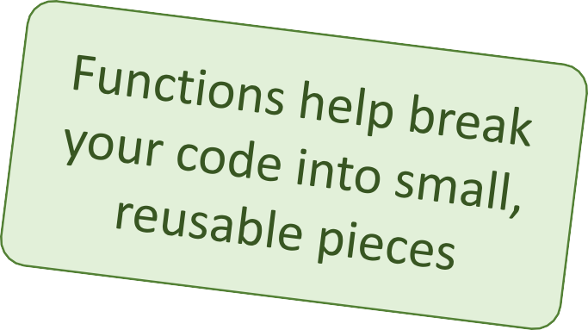
Components
Components are functions for user interfaces
Input x
Output number
Math function:
let y = f(x);
Input x
Output HTML
Component function:
let y = <FancyDiv value={x} />;

Slide 15
Anatomy of a React component
The component is just a function
Inputs are passed through a single argument called “props”
The function outputs HTML
export default function MyComponent(props) {
return <div>Hello, world! My name is {props.name}</div>;
}
const html = <MyComponent name="aaron" />;
The function is executed as if it was an HTML tag
Parameters are passed in as HTML attributes

Slide 16
JSX Syntax in React
import React from 'react';
function App() {
const name = 'John Doe’;
return (
<div className="App">
<h1>Hello, {name}!</h1>
<p>Welcome to my React app.</p>
</div>
);
}
JSX is a syntax extension for JavaScript that allows you to write HTML-like code in your JavaScript files. In React, JSX is used to define the structure and content of components.
The code defines a simple React component called App.
The App component uses JSX syntax to define its structure and content.
JSX allows you to embed JavaScript expressions in curly braces, like {name} in the example.
JSX also allows you to add CSS classes to elements using the className attribute.
When the App component is rendered, it will display an h1 tag with the text "Hello, John Doe!", a p tag with the text "Welcome to my React app.", and a div element with the class "App".

Slide 17
Styling
import React from 'react';
import styled from 'styled-components';
const StyledButton = styled.button`
background-color: #3498db;
color: white;
font-size: 1em;
padding: 0.5em 1em;
border: none;
border-radius: 3px;
`;
function App() {
return (
<div>
<h1>Welcome to my React application!</h1>
<p>Here's a styled button:</p>
<StyledButton>Click me!</StyledButton>
</div>
);
}
export default App;
Styling is an important aspect of any web application, and React provides several ways to style components and applications, including
regular HTML/CSS styling inline
in <style> elements
in dedicated .css files, using selectors
In this example, we do something different:
The code uses the styled-components library to define a styled button component with CSS-in-JS.
The StyledButton component is defined with CSS properties to define the button's style.
The App component uses the StyledButton component to render a styled button.
CSS-in-JS libraries like styled-components provide a powerful and flexible way to style React components with CSS-in-JS.
  This approach also allows for keeping less unused CSS over time

Slide 18
Component rendering
When a component function executes, we say it “renders”
Assume components may re-render at any time
Our job is to ensure that
every time the component re-renders, the correct output is produced

Slide 19
“In React, everything is a component”

Slide 20
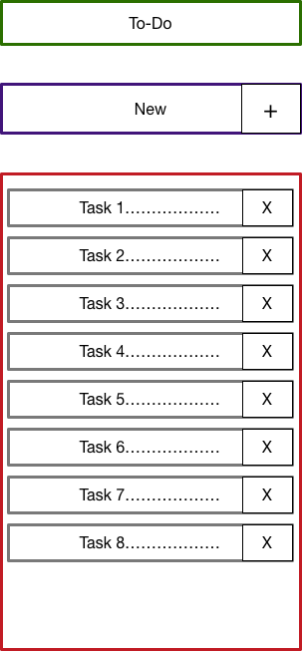
Todo application
Title
Big idea:
A digital to-do list
TodoForm
First step:
mockup / wireframe
TodoList
Todo

Slide 21
Install React
Before getting started with React, you need to install it on your computer. In this section, we will explore the various methods for installing React and the necessary tools and dependencies.
Installing React with npm or Yarn
Creating a new React project with Vite (NOT CRA create-react-app ! )
Set up a development environment with a code editor and browser
  VS Code + Prettier
  Google Chrome + React Dev Tools Extension
Install and configure necessary dependencies, such as Vite
Troubleshooting common installation issues
Best practices for managing React installations and dependencies
-> sudo npm create vite@latest
-> y
-> React
-> Typescript

Slide 22
Creating a new React app
Creating a new React app is simple!
Install Node.js
Run: sudo npm create vite@latest
New app created in folder: ./app-name
Run: npx create-react-app app-name

Slide 23
Simple React App
The code imports React and ReactDOM, which are necessary for rendering React components in the browser.
The App function is a simple React component that returns a div containing an h1 tag with the text "Hello, World!".
The ReactDOM.render function renders the App component inside the root element of the HTML document.
When the code is run, the browser will display the text "Hello, World!" in an h1 tag on the page.
import React from 'react';
import ReactDOM from 'react-dom';
function App() {
return (
<div>
<h1>Hello, World!</h1>
</div>
);
}
ReactDOM.render(<App />,
document.getElementById('root'));

Slide 24
React Components
Class Component
import React from 'react';
class Counter extends React.Component {
constructor(props) {
super(props);
this.state = { count: 0 };
}
render() {
return <div>{this.state.count}</div>;
}
}
export default Counter; // or export { Counter };
React is built around the concept of components, which are the building blocks of a React application.
A component is typically in its own file and export its root function.
Functional Component
import React from 'react';
function Greeting(props) {
return <h1>Hello, {props.name}!</h1>;
}
export default Greeting; // or export { Greeting };

Slide 25
Functional Components
import React from 'react';
function Greeting(props) {
return <h1>Hello, {props.name}!</h1>;
}
Functional components are a simpler and more concise way of defining React components.
The code defines a simple functional component called Greeting.
The Greeting component takes a name prop and returns an h1 tag with the text "Hello, {props.name}!".
Functional components are simpler and easier to read than class components.
Functional components are also faster to render, since they don't have the overhead of a class instance.
Functional components cannot have state or lifecycle methods on their own, but they can use hooks to manage state and perform side effects.

Slide 26
Class Components
import React from 'react';
class Counter extends React.Component {
constructor(props) {
super(props);
this.state = { count: 0 };
}
render() {
return <div>{this.state.count}</div>;
}
}
Class components are a more powerful way of defining React components.
The code defines a simple class component called Counter.
The Counter component has an internal state (count) and a render method that returns the value of this.state.count.
Class components are more powerful than functional components and can have additional functionality like state and lifecycle methods.
Class components are more verbose and harder to read than functional components.
Class components will eventually be phased out in favor of functional components with hooks.

Slide 27
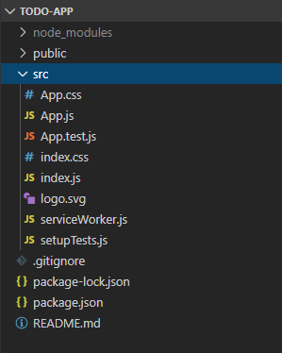
Anatomy of a new React app
public holds the initial html document and other static assets
App is a boilerplate starter component
index.js binds React to the DOM
package.json configures npm dependencies

Slide 28
Component Hierarchy
Title
TodoForm
App
Title
TodoList
TodoForm
TodoList
Todo
Todo
Todo
Todo

Slide 29
Special list key property
Situation: Display a dynamic array of elements
Must specify a special “key” property for each element
The key of an item uniquely identifies it
Used by React internally for render optimization
Can be any unique value (string or number)

Slide 30
What are hooks?
Hooks: Special functions that allow developers to hook into state and lifecycle of React components.
Built-in hooks:
useState
We will cover these today
useEffect
State: One or more data values associated with a React component instance.
useReducer
We will not cover
these today
useMemo
Lifecycle: The events associated with a React component instance (create, render, destroy, etc).
useRef
useCallback

Slide 31
First React hook: useState
Purpose:
Remember values internally when the component re-renders
Tell React to re-render the component when the value changes
Syntax:
const [val, setVal] = useState(100);
The current value
A setter function to change the value
The initial value to use

Slide 32
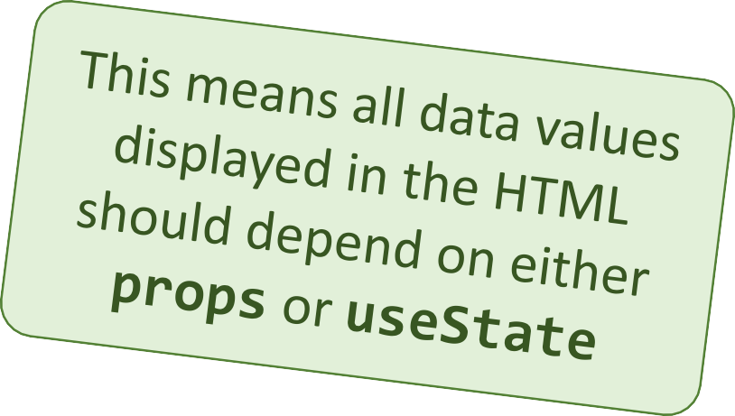
Predicting component re-rendering
A component will only re-render when…
A value inside props changes
– or –
A useState setter is called

Slide 33
Second React hook: useEffect
Purpose:
Act as an observer, running code in response to value changes
Syntax:
useEffect(() => {
console.log(`myValue was changed! New value: ${myValue}`);
}, [myValue]);
A list of values such that changes should trigger this code to run
The code to run when values change

Slide 34
Simple example
import React, { useState, useEffect } from 'react';
function MyComponent() {
// Step 1: Initialize x with a value of 5
const [x, setX] = useState(5);
// Step 3: React to changes in x
useEffect(() => {
console.log(`The value of x is now ${x}`);
// This code will run whenever 'x' changes
}, [x]); // The dependency array
// A function to update x
const updateX = () => {
// Step 2: Update x to 6
setX(6);
};
return (
<div>
<p>The value of x is: {x}</p>
<button onClick={updateX}>Change x to 6</button>
</div>
);
}
export default MyComponent;
We want to show the value x on screen, but the shown value should be updated wherever it is shown, when the variable is updated.
To acheive this, we use "state" to set and alter the value of x, so that we can trigger hooks on state changes.

Slide 35
Building a React project
When you’re ready to launch your app, run this command:
npm run build
This bundles your app into CSS/JS/HTML files and puts them in the
/build folder
These files can be served from an AWS S3 bucket

Slide 36
3rd party components and libraries
React-Router
Redux
Material-UI
Bootstrap
Font-Awesome
SWR

